Slide 1
Addressing Teen Drug Use
Marilyn B. Benoit, M.D.
Chief Medical Officer
Helena, Montana
October 6, 2015

Slide 2
Goals of Lecture
The adolescent passage: an overview.
The teen brain: What’s different about it?
Genetics of drug abuse.
The neurobiology of drug abuse.
Prescription drug use/abuse & the role of families.
Psychiatric disorders and drug abuse.
How to engage teenagers in resisting drug abuse.

Slide 3
Adolescent Passage
Age 12 to 22
Puberty: a physiological phenomenon that involves reproductive hormones coming on-line, significant physical changes, cognitive changes and emotional and behavioral changes.
Adolescence: the developmental journey from childhood to adulthood.

Slide 4
Major Tasks of Adolescence
Separation/individuation from parents.
What does this mean?
Have to establish oneself as being “different from” the parents.
Shift from involvement with parents to involvement with peers.
Shift in professed values.
With abstract thinking there is a sense of knowing more than parents.
BUT THEY STILL NEED YOU TO BE THERE!!!!!

Slide 5
From IOM’s Neurons to Neighborhoods
“The purpose of a brain is to store, use, and create information.”
Humans acquire information primarily from experience, including their systems for thinking, feeling and communicating.

Slide 6
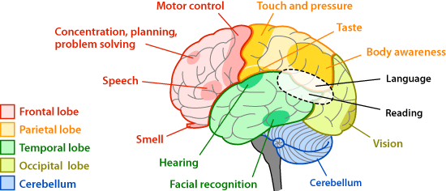

Slide 7
Basic Tasks of the Brain
Frontal lobe structures highly influence: regulation of affective behavior, cognitive/emotional link leading to self-control involved.
Large amount of brain dedicated to social-emotional tasks.
Different systems do not necessarily grow “in sync.”

Slide 8
Developmental Milestones of the Brain
Frontal lobe rapid growth ages 3 to 6: attention, vigilance, alertness.
Temporal/parietal lobes ages 7 to 15: rapid growth with focus on language and mathematics.
Frontal lobe ages 16 to 20: dendritic pruning with focus on self control, planning, and behavior regulation.

Slide 9
Cerebellar Development for 145 Children and Adolescents (Ages 4-22)
Based on 243 Brain MRI Scans
= Peak
Cerebellum vs. Other Peaks:
* <.002, ** <.0001

Slide 10
The Adolescent Brain
Concept of adolescence as “Second Chance.”
Significant neural maturation takes place in the brain during puberty and into late adolescence.
Concept of “pruning.”

Slide 11
Brain Development in Healthy Children and Adolescents: Longitudinal and Cross-Sectional Data (243 Scans from 145 Subjects)

Slide 12
Executive Functions
Organizing
Prioritizing
Planning
Utilizing working memory
Accessing recall
Focusing
Work Initiation
Sustaining a task
Shifting attention (transitioning)
Regulating alertness
Pacing oneself (time management)
Managing frustration
Modulating emotions
Brown, T. CHADD Attention Feb. 2003

Slide 13
From IOM’s Neurons to Neighborhoods
New experiences trigger new brain growth and this is how memories, knowledge and learning takes place across the life span.
Genes and environment have delicate interplay (nurture/nature).
Relationships provide critical transactional variable.

Slide 14
What changes?
Impulsivity increases.
Risk taking increases.
Boys are more likely than girls to take greater risks. It’s what we call “testosterone poisoning!!”
They will lie to you. And you will know it. Don’t try to trap them. Just tell them what you know.

Slide 15
The Need for Different Parenting Skills
It’s no longer about taking care of and planning the young person’s day-to-day life anymore.
Child has shifted from being dependent to acquiring increasingly independent skills.
This requires the parents to gradually “let go!”
That is a frightening shift for parents.

Slide 16
Parents’ Dilemma: Walking the Tight Rope.
Yet Parents must be VIGILANT!!
How can parents let go and supervise at the same time?
Surely cell phones must make it easier! Really??
The “kids” need some “space” that is their own: how is this to be managed??

Slide 17
What NOT to do!
Do not denigrate their friends. Express concern about behaviors.
DO NOT SHAME THEM in front of others.
DO NOT call them negative names, e.g. “loser.”
DO NOT give them everything they desire. Let them work for items that are “prized,” but not essential.

Slide 18
What TO DO
Remain the adult. But forgive yourself for those times when you lose it! Nobody’s perfect! And apologize. It’s OK, and the modeling will go a long way.
Also forgive them when they do stupid stuff and get in trouble.
To be effective, consequences must be brief even when you want to lock them up for the rest of their lives!!!

Slide 19
So what can parents really DO??
Maintain being parents. You are not friends to your children.
Maintain clear, age appropriate rules.
Specify your expectations for their and their friends’ behaviors when around you.
Give POSITIVE support.
Be clear about consequences: AND ENFORCE THEM!!

Slide 20
How Can We Intervene?
Teach good parenting practices and intervene with negative situations, e.g. domestic violence, chronic anger in family, abuse & neglect, substance abuse.
Behavior management, psychotherapy, medication, education and cognitive/behavioral interventions.
Advocate for provision of basic needs (health, housing, food, education) to all people.

Slide 21
Teen Drug Use & The Brain on Drugs

Slide 22
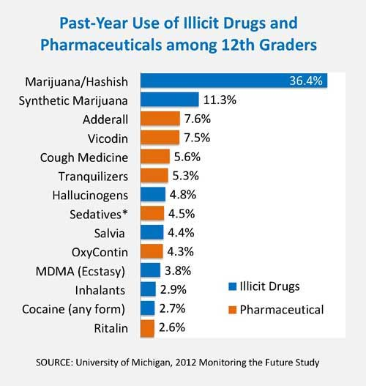

Slide 23
Genes & Drug Abuse
Genes and environment interaction: what we know is that a genetic substrate that favors addiction would facilitate drug abuse when environmental factors are conducive.
Family history generally provides clues about addiction. Some family members who have witnessed the devastation of drug abuse in others are totally avoidant of all potential drugs of abuse.
Trauma of all kinds can create a setting that facilitates drug use/abuse, e.g. PTSD in veterans.

Slide 24
The following slide presentation on the brain and drugs is excerpted from the National Institute on Drug Abuse, Nora Volkow, M.D., Director

Slide 25
Notes:
Introduction
Introduce the topic of your talk. Indicate that you will explain how the brain basically works and how drugs such as cocaine, opiates and marijuana interact with the brain's normal activities. Tell students that you will introduce the concept of "reward" which is the property that is characteristic of many addictive drugs. Describe the brain as a functional unit; it is made up of billions of nerve cells (neurons) that communicate with each other using electrical and chemical signals.

Slide 26
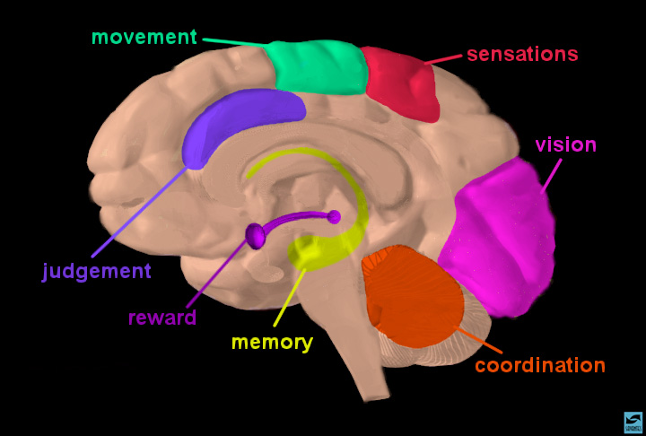
Notes:
Brain regions and neuronal pathways
Certain parts of the brain govern specific functions. Point to sensory, motor, association and visual cortex to highlight specific functions. Point to the cerebellum for coordination and to the hippocampus for memory. Indicate that nerve cells or neurons travel from one area to another via pathways to send and integrate information. Show, for example, the reward pathway. Start at the ventral tegmental area (VTA) (in magenta), follow the neuron to the nucleus accumbens, and then on to prefrontal cortex. Explain that this pathway gets activated when a person receives positive reinforcement for certain behaviors ("reward"). Indicate that you will explain how this happens when a person takes an addictive drug.

Slide 27
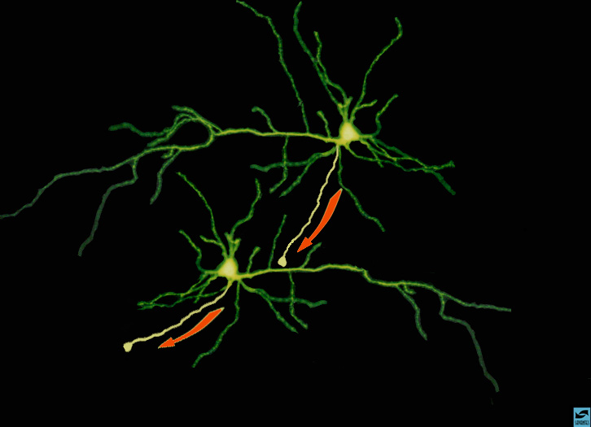
Notes:
Summary of neuronal transmission
Use the example with 2 neurons making contact to summarize neuronal transmission. Point to the cell on the top and indicate that electrical impulses flow in the direction toward the terminal. Remind the students what happens when impulses reach the terminal; neurotransmitters are released, they bind to their receptors, and new impulses are generated in the cell on the bottom. Explain that this is how information travels from neuron to neuron.

Slide 28
Receptor Sites at Synapses

Slide 29
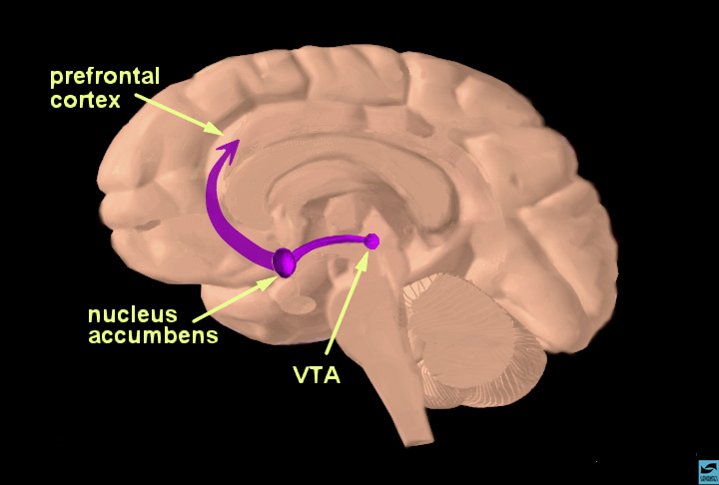
Notes:
The reward pathway
Tell students that this is a view of the brain cut down the middle. An important part of the reward system is shown and the major structures are highlighted: the ventral tegmental area (VTA), the nucleus accumbens (nuc. acc.) and the prefrontal cortex. Also, the pathway connecting these structures is highlighted. The information travels from the VTA to the nucleus accumbens and then up to the prefrontal cortex. Reiterate that this pathway is activated by a rewarding stimulus. [Note to scientists - this is not the only pathway activated by reward, other structures are involved too, but only this part of the pathway is shown for simplicity.]

Slide 30
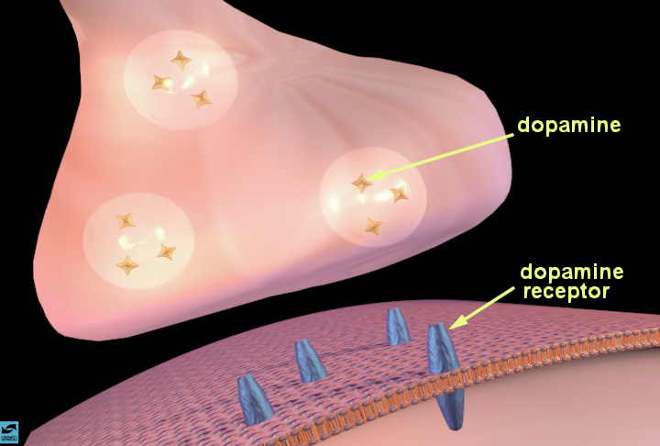
Notes:
The synapse and synaptic neurotransmission
Describe the synapse and the process of chemical neurotransmission. Indicate how vesicles containing a neurotransmitter, such as dopamine (the stars), move toward the presynaptic membrane as an electrical impulse arrives at the terminal. Describe the process of dopamine release (show how the vesicles fuse with the presynaptic membrane). Once inside the synaptic cleft, the dopamine can bind to specific proteins called dopamine receptors (in blue) on the membrane of a neighboring neuron. Introduce the idea that occupation of receptors by neurotransmitters causes various actions in the cell; activation or inhibition of enzymes, entry or exit of certain ions. State that you will describe how this happens in a few moments.

Slide 31
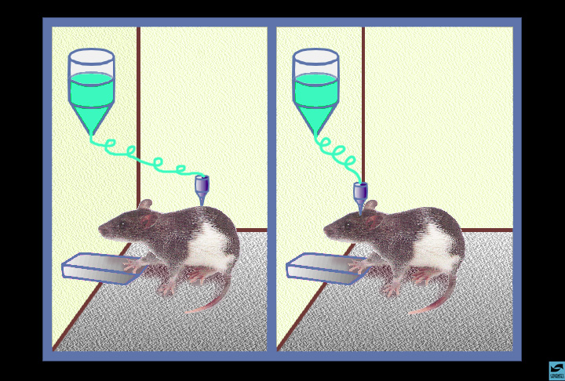
Notes:
Reward: drug self-administration
Introduce the concept of positive reinforcement or reward. Explain that rats will press a bar to get an injection of cocaine or heroin (self-administration - shown on the left). The rat keeps pressing to get more cocaine or heroin because the drugs make the rat feel so good. This is called positive reinforcement, or reward. Natural rewards include food, water and sex - each is required to maintain survival of our species. Animals and people will continue to exhibit a behavior that is rewarding - and they will cease that behavior when the reward is no longer present. Explain that there is actually a part of the brain that is activated by natural rewards and by artificial rewards such as addictive drugs. This part of the brain is called the reward system. Neuroscientists have been able to pinpoint the exact parts of the brain involved, with the help of the rats. Point to the cartoon on the right and explain that rats will also self-administer addictive drugs directly into their brains -but only into a specific area of the reward system. If the injection needle is moved less than a millimeter away from this crucial area, the rat won't press the lever for more drug. So based on information from working with the rats, scientists have drawn a map of the brain, and located the structures and pathways that are activated when an addictive drug is taken voluntarily. Tell the students that you will show them this "map".

Slide 32
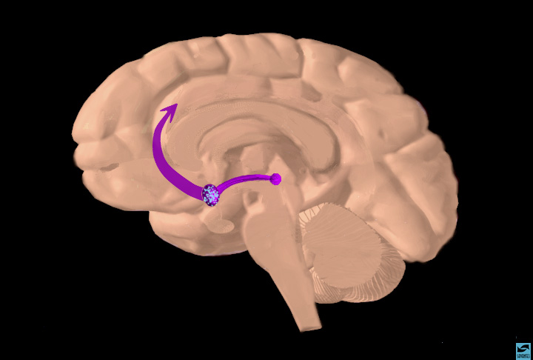
Notes:
Summary; opiate binding in nucleus accumbens and activation of the reward pathway
Show the "big picture". As a result of opiate actions in the nucleus accumbens (point to the sprinkles of opiates in the nuc. acc.), there are increased impulses leaving the nucleus accumbens to activate the reward system (point to the frontal cortex). As with cocaine, continued use of opiates makes the body rely on the presence of the drug to maintain rewarding feelings and other normal behaviors. The person is no longer able to feel the benefits of natural rewards (food, water, sex) and can't function normally without the drug present.

Slide 33
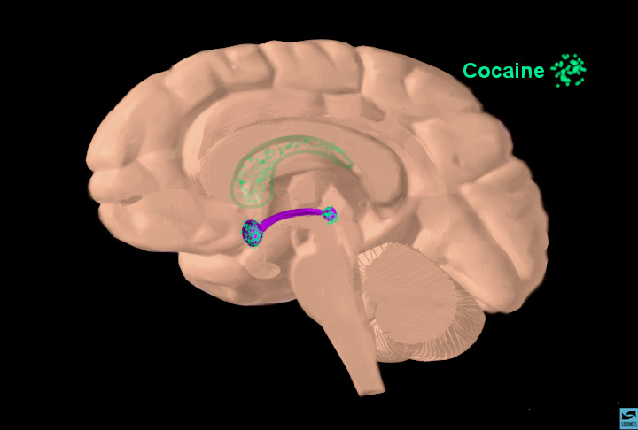
Notes:
Localization of cocaine "binding sites"
When a person smokes or snorts cocaine, it travels quickly to the brain. Although it reaches all areas of the brain, it concentrates in some specific areas. These are highlighted with the turquoise sprinkles; the VTA, the nucleus accumbens and the caudate nucleus (lighter turquoise since the caudate is inside the hemisphere). Point out that cocaine concentrates especially in the reward areas that you have just discussed. Cocaine accumulation in other areas such as the caudate nucleus can explain other effects such as increased stereotypic behaviors (pacing, nail-biting, scratching, etc..)

Slide 34
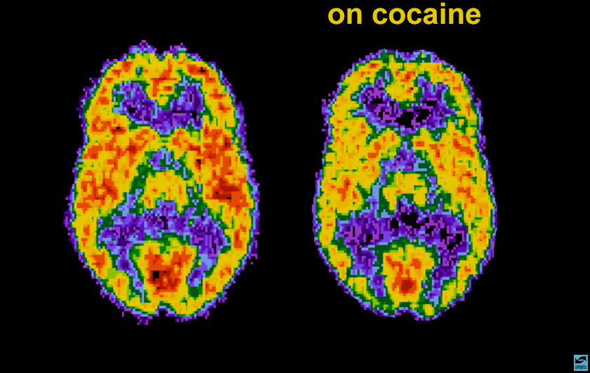
Notes:
Positron emission tomography (PET) scan of a person on cocaine
Cocaine has other actions in the brain in addition to activating reward. Scientists have the ability to see how cocaine actually affects brain function in people. The PET scan allows one to see how the brain uses glucose; glucose provides energy to each neuron so it can perform work. The scans show where the cocaine interferes with the brain's use of glucose - or its metabolic activity. The left scan is taken from a normal, awake person. The red color shows the highest level of glucose utilization (yellow represents less utilization and blue shows the least). The right scan is taken from a cocaine abuser on cocaine. It shows that the brain cannot use glucose nearly as effectively - show the loss of red compared to the left scan. There are many areas of the brain that have reduced metabolic activity. The continued reduction in the neurons' ability to use glucose (energy) results in disruption of many brain functions.

Slide 35
Notes:
Localization of opiate binding sites
When a person injects heroin or morphine, it too, travels quickly to the brain. Point to the areas where opiates concentrate. The VTA, nucleus accumbens, caudate nucleus and thalamus are highlighted. The opiates bind to opiate receptors that are concentrated in areas within the reward system. Indicate that the action of opiates in the thalamus contributes to their ability to produce analgesia.

Slide 36
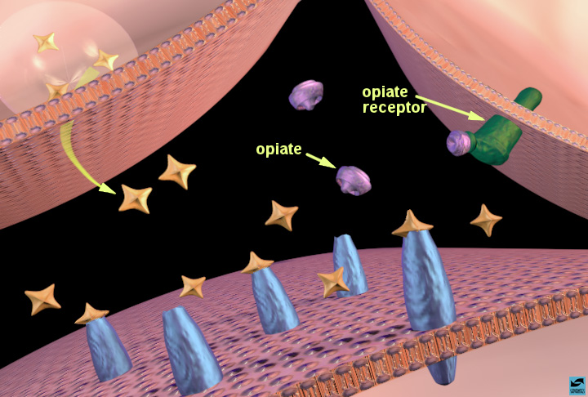
Notes:
Opiates binding to opiate receptors in the nucleus accumbens: increased dopamine release
Show how opiates activiate the reward system using the nucleus accumbens as an example. Explain that the action is a little more complicated than cocaine's because more than two neurons are involved. Point out that 3 neurons participate in opiate action; the dopamine terminal, another terminal (on the right) containing a different neurotransmitter (probably GABA for those that would like to know), and the post-synaptic cell containing dopamine receptors. Show that opiates bind to opiate receptors (green) on the neighboring terminal and this sends a signal to the dopamine terminal to release more dopamine. [In case an inquisitive student asks how - one theory is that opiate receptor activation decreases GABA release, which normally inhibits dopamine release - so dopamine release is increased.]

Slide 37
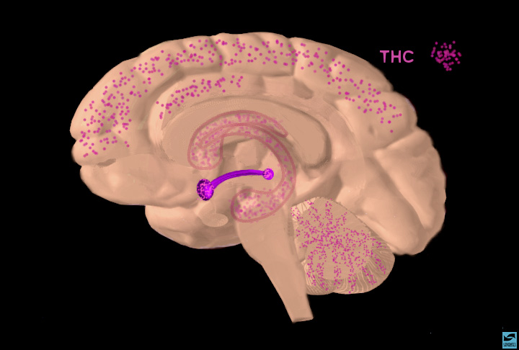
Notes:
Localization of THC binding sites
When a person smokes marijuana, the active ingredient, cannabinoids or THC, travels quickly to the brain. Point to the areas where THC (magenta) concentrates. The VTA, nucleus accumbens, caudate nucleus, hippocampus, and cerebellum are highlighted. THC binds to THC receptors that are concentrated in areas within the reward system as well as these other areas. Indicate that the action of THC in the hippocampus explains its ability to interfere with memory and actions in the cerebellum are responsible for its ability to cause incoordination and loss of balance.

Slide 38
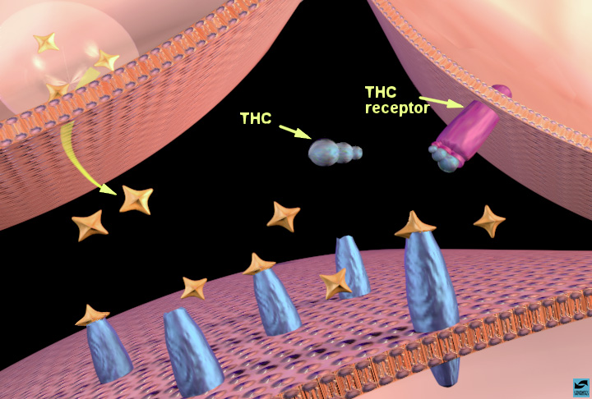
Notes:
THC binding to THC receptors in the nucleus accumbens: increased dopamine release
[Note to scientists - the interaction of THC with the reward system is not fully understood at this point. The following discussion is based on recent data, but additional theories may emerge as we obtain more data.] State that scientists know the least about THC. Over the last few years, there has been intense study to discover where and how THC works. One theory is that it acts in a similar way to opiates. Again use the nucleus accumbens as an example. The same 3 neurons are probably involved; the dopamine terminal, another terminal (on the right) containing a different neurotransmitter (probably GABA), and the post-synaptic cell containing dopamine receptors. Ask the students if they can tell you how THC might work. THC binds to THC receptors (magenta) on the neighboring terminal and this sends a signal to the dopamine terminal to release more dopamine. [Again, it is probably a presynaptic receptor on GABA interneurons that controls dopamine release.]

Slide 39
Notes:
Overall summary; these drugs of abuse all activate the reward system via increasing dopamine neurotransmission
In this last slide, the binding of all 3 drugs is shown in one of the reward areas, the nucleus accumbens. Summarize that each drug increases the activity of the reward pathway by increasing dopamine transmission. This happens even though the drugs act by different mechanisms. Because of the way our brains are designed, and because these drugs activate a particular brain pathway for reward, they have the ability to be abused.
Start a discussion; ask the students if they can think of any other drugs that are abused that probably activate the reward system in the same way. Answer: alcohol, nicotine, and amphetamine are good examples.

Slide 40
Parents’/Families’ Role in Teen Prescription Drug Use/Abuse
Teenagers report that they steal pills from their parents and/or family members who have pain meds for treatment of various orthopedic ailments.
Babysitters raid medicine cabinets.
Teenagers share pills and sell them.
Cocaine, opiates and stimulants are hot commodities on college campuses.
Message: LOCK UP ALL MEDICATIONS!!!

Slide 41
From NIDA:
Research shows that alcohol abuse during the teenage years negatively impacts the memory center of the brain (the hippocampus).
The use of drugs and alcohol may also disrupt the development of the adolescent brain in unhealthy ways, making it harder for teens to cope with social situations and the normal pressures of life.

Slide 42
What are ACEs?
Refer to adverse childhood experiences prior to age 18.
They include: emotional, physical and sexual abuse (includes bullying of all types).
Emotional and physical neglect.
Family negative events: domestic abuse, substance abuse, mental illness, parental separation or divorce, parental incarceration.

Slide 43
Adverse Childhood Experiences, or ACEs
Cumulative early exposure to traumatic events can lead to poor mental and physical health, less success at school and work, lower socioeconomic status in adulthood and early mortality.
ACEs scores for Montana children are among the three highest in the country.

Slide 44
ACEs Pyramid
Centers for Disease Control & Prevention

Slide 45
Role of Psychiatric Disorders in Drug Abuse
These are all BRAIN DISORDERS!!
What comes first?
Brain research is providing insights into early manifestations of later diagnosed psychiatric disorders.
ADHD as early warning of later developing problems: anxiety, bipolar disorder, depression, other disruptive behavior disorders.

Slide 46
Risks Related to Psychiatric Disorders
ADHD:
Diversion of stimulant medications (selling)
Snorting of crushed drug
Increasing dosage without doctor’s approval
The use of Vyvanse (called a pro-drug) is an attempt by the manufacturer to decrease abuse of the amphetamine.

Slide 47
Risks Related to Psychiatric Disorders
Bipolar Disorder:
Mood swings make use of stimulants and depressants more appealing. Cocaine can lift depressed moods, and alcohol & heroin can dampen a manic episode. There is a high risk of substance abuse complicating the treatment of bipolar disorder.

Slide 48
Risks Related to Psychiatric Disorders
Depression:
Alcohol dependency because of the easy availability of alcohol.
Other drug abuse: “benzos,” amphetamines (cocaine, stimulants, “meth”) most likely.

Slide 49
Risks Related to Psychiatric Disorders
Anxiety:
Abuse of anxiolytics (usually benzodiazepines)
Alcohol dependency because alcohol initially calms anxiety
Can result in serious (sometimes lethal) outcomes when combined with opiates (heroin, methadone)

Slide 50
Question of Self-medicating
Possible that drug of choice related to some underlying brain dysfunction that could be genetically present.
Life circumstances create overwhelmingly prolonged stress for individuals who perceive no solutions.
Drugs and alcohol provide instant relief by soothing the reward system of the brain, and this reinforces drug taking behavior.

Slide 51
Notes:
Overall summary; these drugs of abuse all activate the reward system via increasing dopamine neurotransmission
In this last slide, the binding of all 3 drugs is shown in one of the reward areas, the nucleus accumbens. Summarize that each drug increases the activity of the reward pathway by increasing dopamine transmission. This happens even though the drugs act by different mechanisms. Because of the way our brains are designed, and because these drugs activate a particular brain pathway for reward, they have the ability to be abused.
Start a discussion; ask the students if they can think of any other drugs that are abused that probably activate the reward system in the same way. Answer: alcohol, nicotine, and amphetamine are good examples.

Slide 52
FROM NIDA
Moreover, the brain’s reward circuits (the dopamine system) get thrown out of whack when under the influence. This causes a teen to feel in a funk when not using drugs or alcohol – and going back for more only makes things worse.
It is important to urge your teen to take healthy risks. Not only will participation in constructive activities – such as athletics or the arts – help him or her form positive lifestyle habits, it will help your teen’s forebrain develop as well.

Slide 53
FROM NIDA
Drug information alone, however, has not been found to be effective in deterring drug abuse. Combining information with skills, methods, and services produces more effective results.
Methods are geared toward change, such as establishing and enforcing rules on drug abuse in schools, at home, and within the community.
Services could include school counseling and assistance, peer counseling, family therapy, and health care.
Parental monitoring and supervision can be enhanced with training on rule-setting; methods for monitoring child activities; praising appropriate behavior; and moderate, consistent discipline enforcing family rules.

Slide 54
Resources
Findtreatment.samhsa.gov
drugfree.org
asam.org
niaaa.nih.gov
drugabuse.gov/about-nida/organization/cctn/ctn
nida.nih.gov
nami.org
NAABT.org
helpmegetoffdrugs.com
aacap.org

Slide 55
FROM NIDA
Preventing Drug Use among Children and Adolescents: A Research-Based Guide for Parents, Educators, and Community Leaders, Second Edition
Drugs, Brains and Behaviors: The Science of Addiction
Marijuana: Facts Parents Need to Know

Slide 56
Marilyn B. Benoit, M.D.
Chief Medical Officer
Devereux
mbenoit@devereux.org
610.542.3004

